Slide 1
Westward Expansion Vocabulary

Slide 2
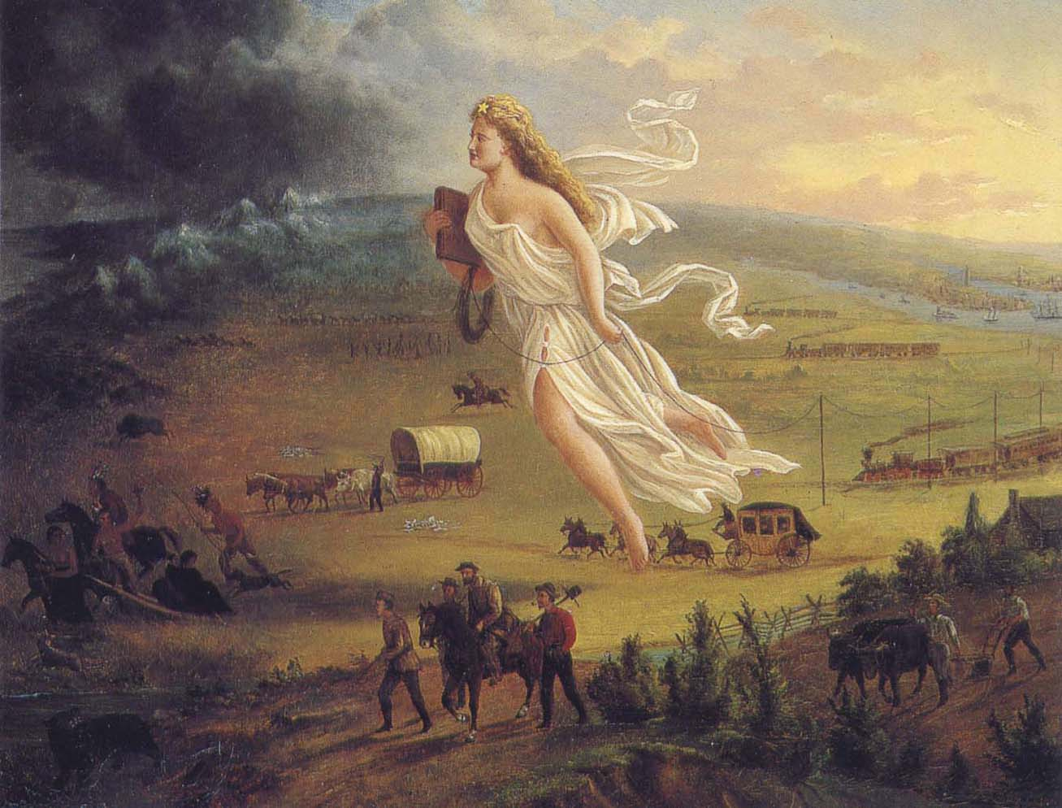
Manifest Destiny
The idea that the United States was meant to stretch from the Atlantic Ocean to the Pacific Ocean

Slide 3
Impressment
The taking of workers against their will

Slide 4
Nationalism
Pride in one’s country

Slide 5
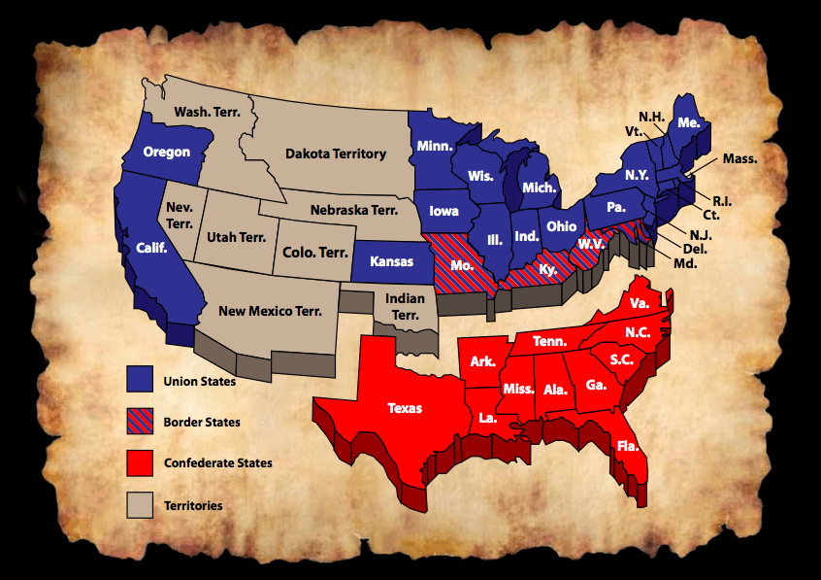
Sectionalism
Having loyalty to one region of the country instead of the country as a whole.

Slide 6
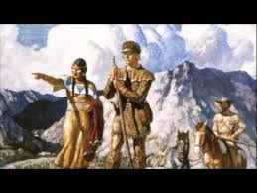
Expedition
A trip taken with the goal of exploring

Slide 7
Geographic Factors
The geography that affects how people make a living in an area (economy), what resources are available to them, and overall way of life.

Slide 8
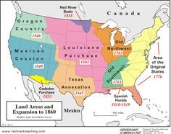
Territory
Land that belongs to a nation but is not a state and is not represented in the national government.

Slide 9
Expansion
When something becomes bigger or more extensive.

Slide 10
Manifest Destiny | The idea that the United States was meant to stretch from the Atlantic Ocean to the Pacific Ocean
Impressment | The taking of workers against their will
Nationalism | Pride in one’s country
Sectionalism | Having loyalty to one region of the country instead of the country as a whole.
Expedition | A trip taken with the goal of exploring
Geographic Factors | The geography that affects how people make a living in an area (economy), what resources are available to them, and overall way of life.
Territory | Land that belongs to a nation but is not a state and is not represented in the national government.
Expansion | When something becomes bigger or more extensive.

Slide 11
Manifest Destiny | The idea that the ________ _________ was meant to _______ from the ____________ _____________ to the ____________ _______
Impressment | The ____________ of __________ against their ___________
Nationalism | __________ in one’s ________________
Sectionalism | Having _______________ to one ____________ of the _________ instead of the __________ as a ____________.
Expedition | A __________ taken with the __________ of ____________
Geographic Factors | The geography that ___________ how ______ make a living in an ____ (economy), what ____________ are available to them, and __________ way of _______.
Territory | _________ that ___________ to a _________ but is not a ______ and is not ____________ in the national ______________________.
Expansion | When ______________ becomes ____________ or more ________________.

