Slide 1
Name: ___________________________ Block: _____
Southwestern Region Homework Packet
Instructions:
Use the states from the word bank below to correctly label each of the states in the Southwest Region. Then match the states with their capitals in the bottom activity.
Arizona
New Mexico
Oklahoma
Texas
_____ Arizona | A. Austin
_____ New Mexico | b. Oklahoma City
_____ Oklahoma | C. Santa Fe
_____ Texas | D. Phoenix

Slide 2
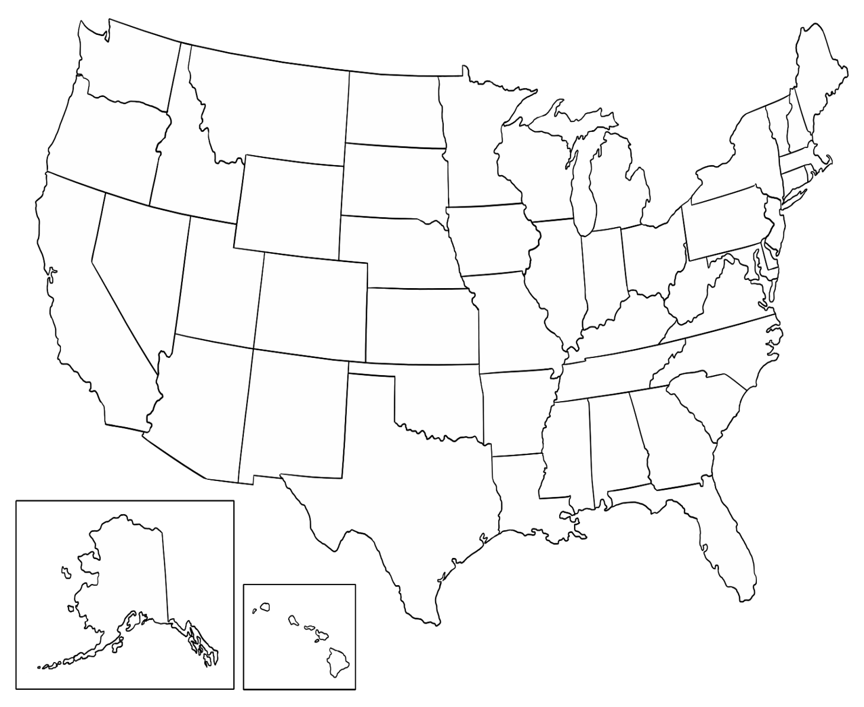
Instructions:
Look at the list of states below in the box. Each of the states is numbered. For each state, find that state on the map and put the correct number in it. For example, put the number 3 in Arizona on the map. Then write the capital of the state in the line beside it’s name.
Texas ________________________
Oklahoma ________________________
Arizona ________________________
New Mexico ________________________

Slide 3
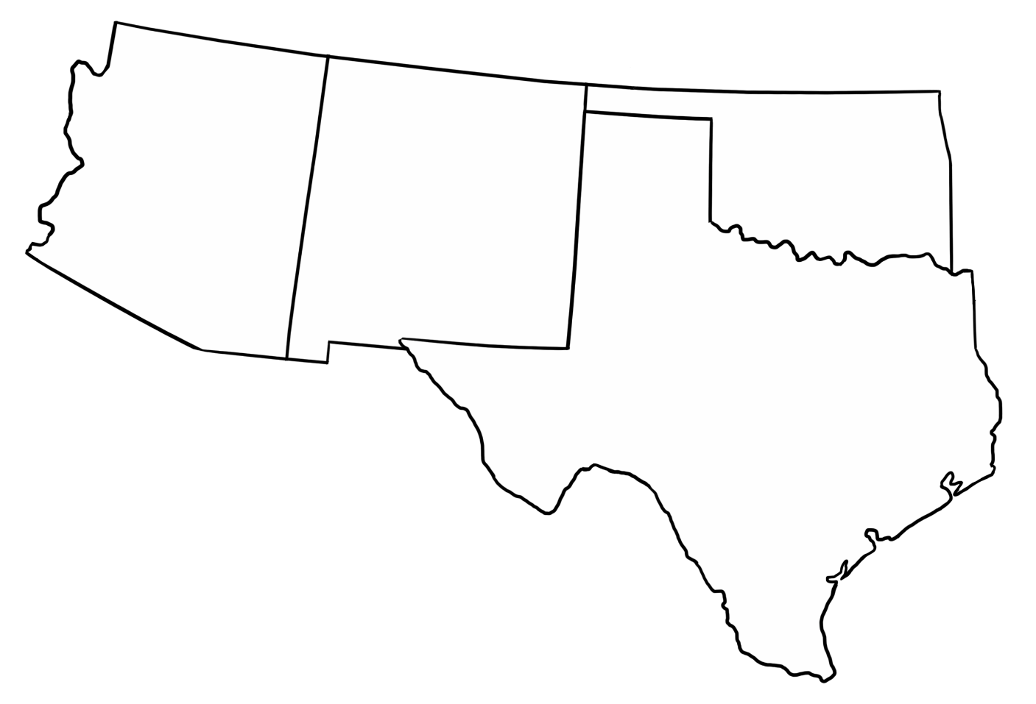
Southwest Region Practice
Instructions:
Find the number in each state. Write that state’s name beside the same number below. Then write the state’s capital on the following line. e Sheet #3
1
2
4
3
Capital: __________________
Capital: __________________
Capital: __________________
Capital: __________________

Slide 4
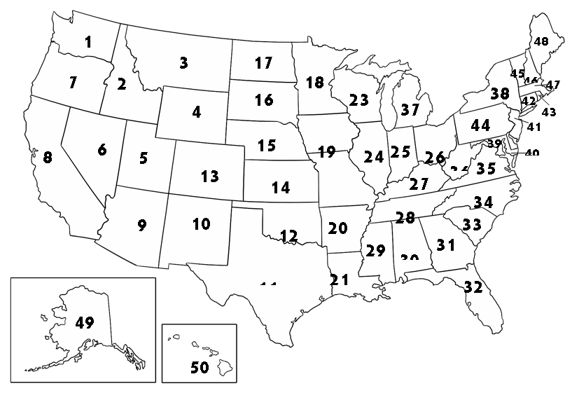
Southwest Region Practice Sheet #4
Instructions: Find all of the states in the Southwest Region.
Complete the chart below, telling for each state: the number in the state, the name of the state, and the state’s capital
12
11
Number: | Name: | Capital:

