Slide 1
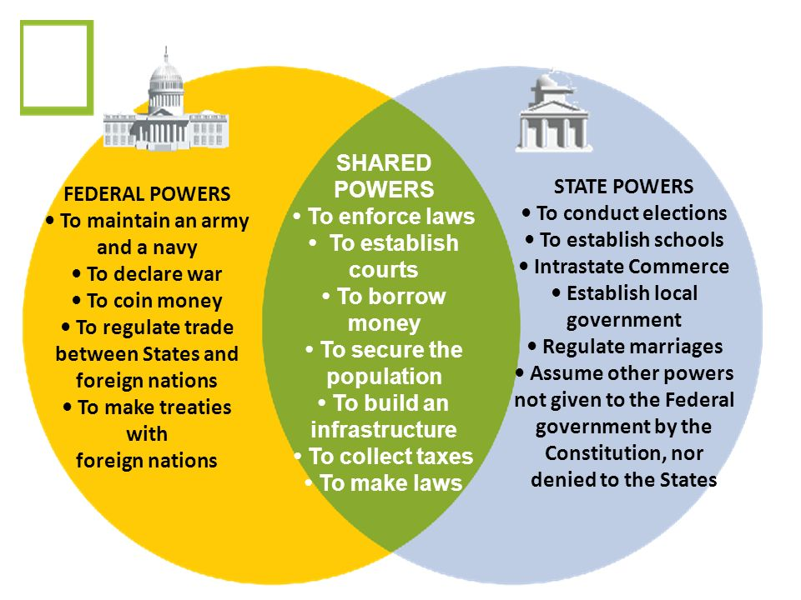
Shared Powers of Federal and State Government

