Slide 1
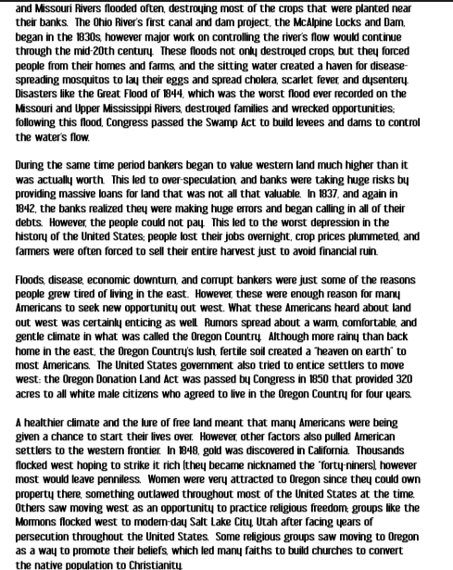

Slide 4
Methods for Mining Gold:
Today, you will be mining for gold using a gold pan. You will need the following supplies in front of you:
Wax Paper
Baggie with sand and gravel
Tweezers
½ cup water
Gold pan
Follow each step in order to strike it rich!
Pour the contents of the baggie into the Gold pan.
Place ½ cup water in the pan over the sand.
Gently rock the pan back and forth until you even out the gravel.
Using the tweezers, search the sand and gravel for any gold that you may see. Remove any gold from the pan with the tweezers.
Place each gold piece inside of the empty baggie.
Empty water out of the pan into the container provided.
Remove all remaining sand from the Gold pan using paper towels and trash can.
Wipe down your area and throw all trash away.
Once done, bring baggie with gold to the teacher to collect your earnings!

Slide 5
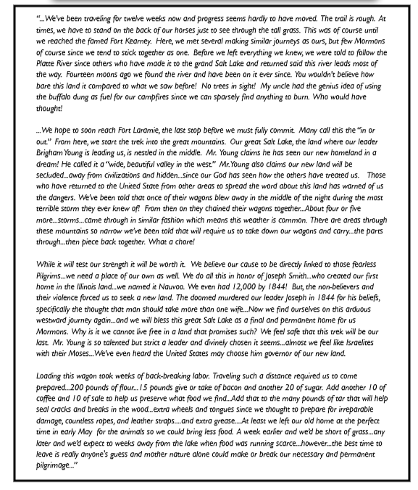
On the Trail with Brigham Young

Slide 6
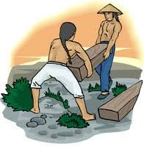
Changing the face of the Nation: Chinese Immigrants
Starting with the Gold Rush, most Chinese immigrants entered California through the port of San Francisco. The Chinese formed part of the diverse gathering of peoples from throughout the world who contributed to the economic and population explosion that characterized the early history of the state of California.
These immigrants proved to be productive and resourceful contributors to a multitude of industries and businesses. The initial group of Chinese argonauts sought their livelihood in the gold mines, calling California Gam Saan or Gold Mountain. Once the Gold Rush came to an end, the Chinese were left with no jobs and no money.
When the 4 men who agreed to finance that transcontinental railroad system set out to build their railroad, they found that it was difficult to hire workers. Irish immigrants were willing to do the hard labor, but there was not nearly enough of them available. The Chinese immigrants who had come to work in the gold and silver mines offered their services.
The Chinese laborers proved that they could indeed keep up. They also showed that they were good engineers, solving difficult construction problems. Once, the Central Pacific Railroad seemed to be at a standstill. The tracks had come to a halt tight at the base of a steep rock cliff. The Chinese laborers wove buckets out of tough reeds. Then they climbed into the buckets and were hauled up the face of the cliff. They chipped away at the rock until there was a ledge large enough to stand on. Then they worked from this ledge, hammering and casting away at the rock. In time, they created a roadway large enough for the railroad bed.
Chinese immigrants came by the shiploads to work on the railroads. Life in their own country was difficult since they could not find work. The chance to work on the railroad, as tough as it was, seemed like an opportunity to these men. Many of them hoped to make some money and then return to China. Some of them did achieve this goal. Others stayed to make a new life in America. Many Chinese laborers died while constructing the railroad. It was very dangerous and difficult work, and thousands of workers of all nationalities were killed in various kinds of accidents.
The Chinese laborers contributed greatly to the building of the railroads. The railroads changed America and made it truly one nations from “sea to shining sea”. The Chinese immigrants helped to build the America we live in today.

Slide 7
Name:_____________________________ Block: ______
WESTWARD EXPANSION:
People Going West Stations
Chinese Immigrants:
How did the Chinese immigrants contribute to the growth of America? _______________________________________________________________________________________________________________________________________________________________
How do you think that the railroads might have changed the lives of the Chinese Immigrants? ____________________________________________________________________________________________________________________________________________________________________________________________________________________
Lasting Impact of the Gold Rush:
True / False:
Most of the men that traveled to California to mine for gold left with little or no money.__________________
List 3 positive outcomes of the California Gold Rush:
__________________________________________________
__________________________________________________
__________________________________________________
List 3 negative consequences of the California Gold Rush:
__________________________________________________
__________________________________________________
__________________________________________________

Slide 8
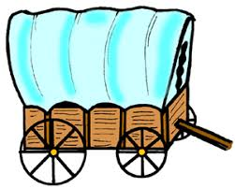
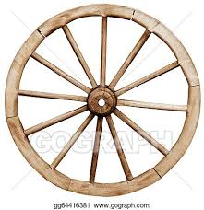
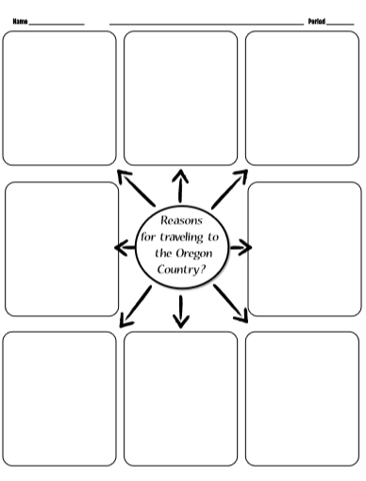
Oregon Fever
Reasons for traveling to the Oregon Country?

Slide 9
In what ways does this source show the difficulty of life along the trail westward?
According to the author’s perspective, explain the process that has forced Mormons to travel west:
On the Trail with Brigham Young
What can be learned about the geography of the west from this author’s account?
What can be learned about Brigham Young’s role in the westward movement of the Mormons?

