Slide 1
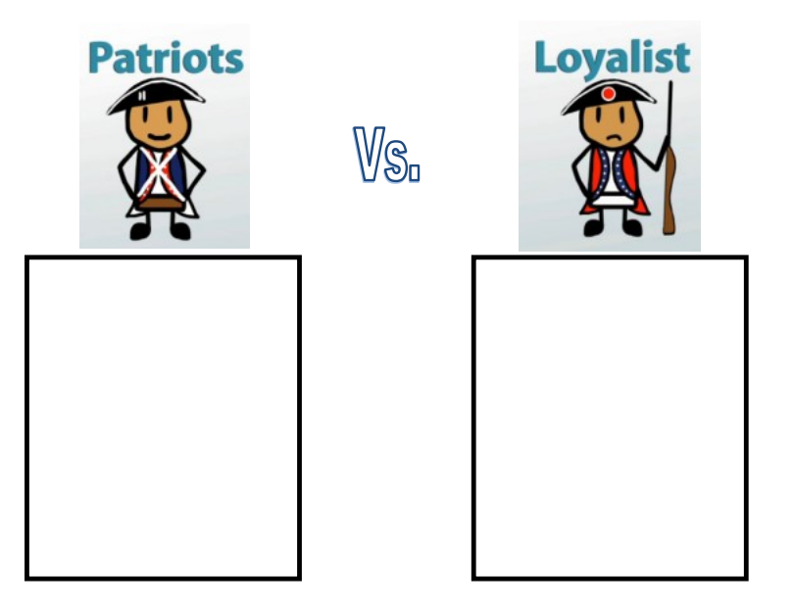

Slide 2
Those who supported independence from Britain.
Felt that British laws on the American Colonies violated their rights as British Citizens
Many Patriots lived in the New England Colonies, Especially Massachusetts.
Colonists who were in debt with British creditors often became Patriots since they hoped winning the Revolution could get them out of paying back their debt.
Those who opposed independence from Britain.
Most tended to be wealthy landowners, clergymen, or has business ties to Britain.
Hoped for a peaceful reconciliation with British government.
Believed that Patriots were the enemy and were committing treason when the group called for Independence from Britain.

