Slide 1
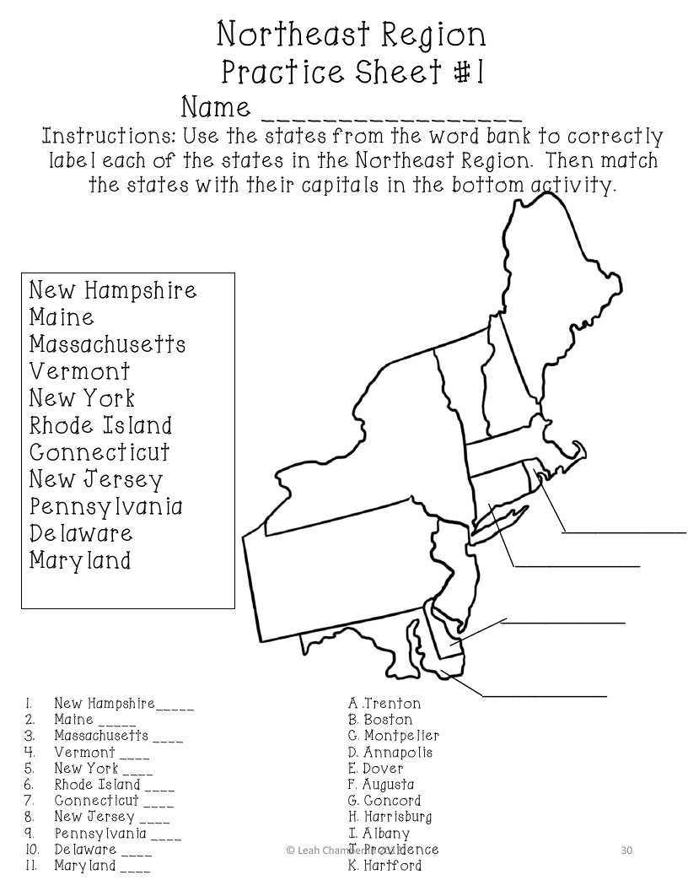
Northeast Region States and Capitals practice packet
1. New Hampshire ___ | Trenton
Maine ___ | Boston
Massachusetts ___ | Montpelier
Vermont ___ | Annapolis
New York ___ | Dover
Rhode Island ___ | Augusta
Connecticut ___ | Concord
New Jersey ___ | Harrisburg
Pennsylvania ___ | I. Albany
Delaware ___ | Providence
Maryland ___ | K. Hartford

Slide 2
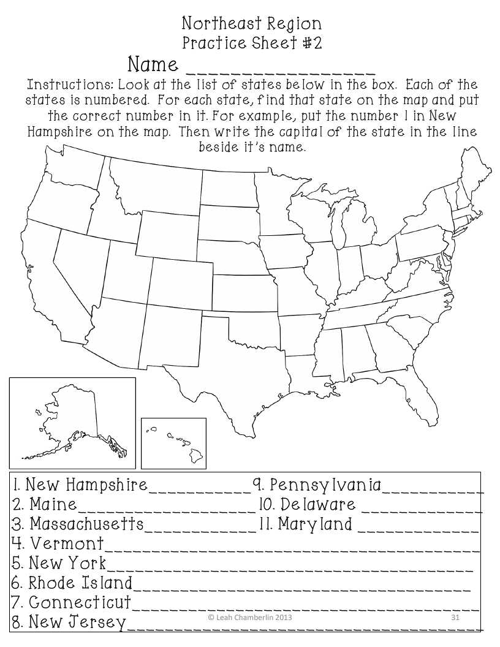

Slide 3
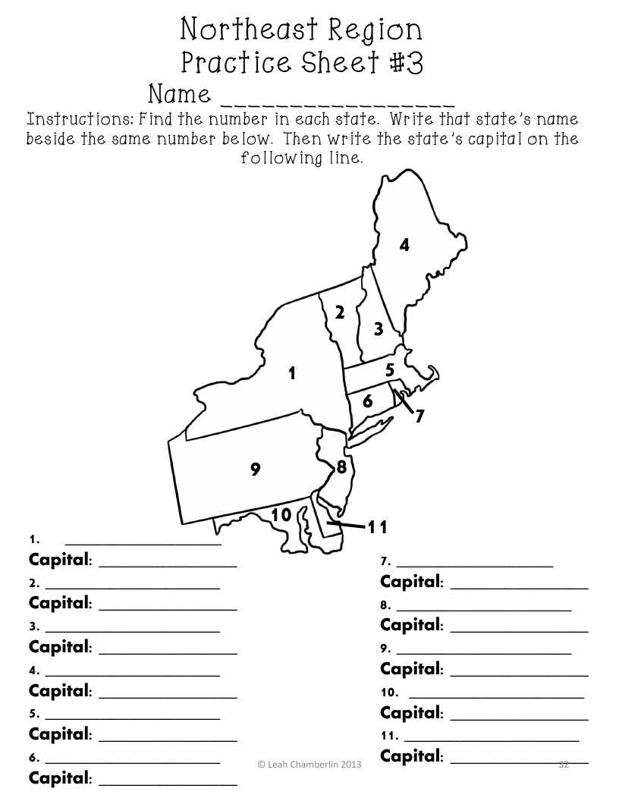

Slide 4
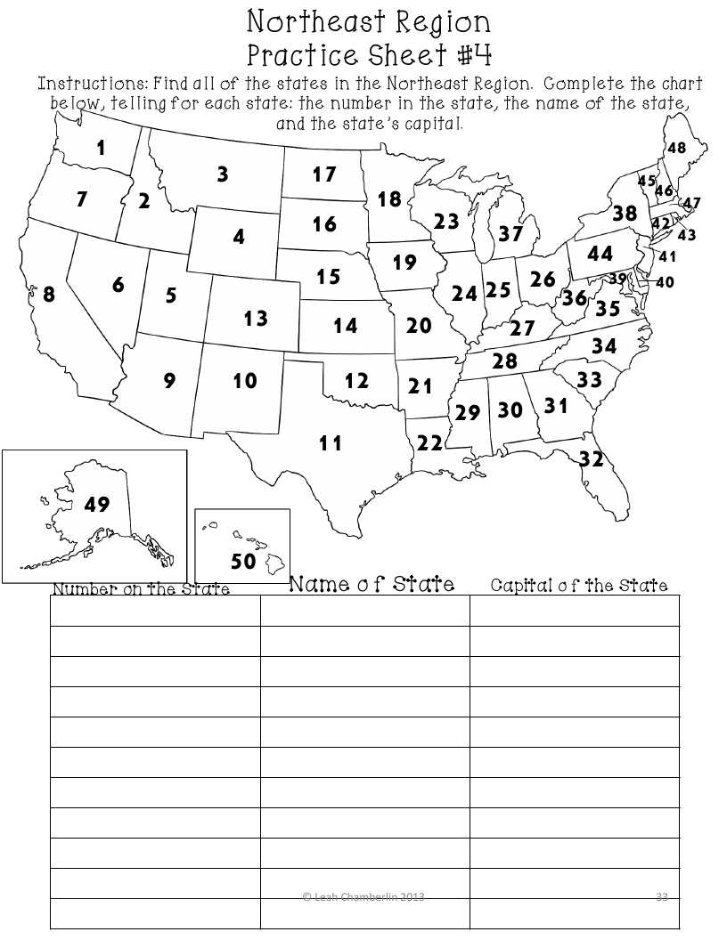
Number of State | Name of State | Name of Capital
48
47
46
45
44
43
42
41
40
39
38

