Slide 1
Name: _____________________________________ Block: _______________
LICENSE PLATE ACTIVITY
Read carefully and complete the attached template by following instructions to create your own license plate as we get ready to “travel” all around the United States of America!
Due Date: Tuesday, September 1st.
Do NOT be late as this will incur late points for your first grade in Social Studies!
Instructions:
In the upper left hand corner, write the month and day that you were born. (10 pts.)
In the upper right hand corner, write your first and last name. (10 pts.)
In the upper middle space, write the name of the state or country of your birth. (10 pts.)
In the center space, use exactly 6 numbers and/or letters to say something about YOU. (40 pts.)
Use the bottom of the page to draw 3 things that you like, collect, or do. (5 pts. each picture)
Completely color your license plate to look nice. Use a LIGHT background so that your work can be seen. (5 pts.)

Slide 2
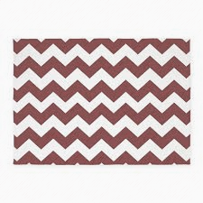
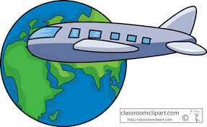
Example:
FEBUARY 3 | VIRGINIA | Amanda Smith
AGGIE3

Slide 3
License Plate Template

