Slide 1
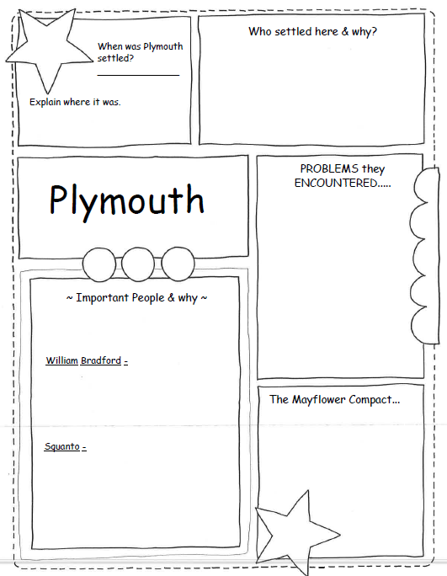
Pilgrims from England wanting religious freedom
Wanted to build a society where everyone shared the same religious beliefs.
1620
Settled at Cap Code, what is now Massachusetts
PLYMOUTH
Push Factors: Church of England would not allow Pilgrims to worship as they wished.
Pull Factors: Land where they had religious freedom and could establish a colony with people that worshipped the same..
Problems the Pilgrims encountered:
Landed too late in the year to plant food.
The winter was cold and long - many died.
Colony became successful, more people came and settled in different area of New England.
Problems started between the colonists and Native Americans. Started pushing Native Americans off their land and tribes started fighting each other for resources.
WILLIAM BRADFORD:
First governor of Plymouth
Helped to make peace with Native Americans in the area.
Eventually turned on the N.A. and agreed to push them off of their land.
The Mayflower Compact:
Men created and signed agreement since there was no government
They needed to keep order. Agreed that fair laws would be made for the good of the colony.
Gave those that signed it the right to govern themselves.
Included the idea of majority rule.
SQUANTO:
Member of the Wamponoag tribe who spoke English.
taken as a slave years earlier and had lived in England.
showed Pilgrims where to fish and how to plant squash, corn, and pumpkins.
He helped them trade for furs from other tribes.

Slide 2
___________ from England wanting ____________ freedom
Wanted to build a society where everyone ___________ the same _____________ ___________.
________
Settled at ________ ______, what is now ____________________.
PLYMOUTH
Push Factors: Church of ___________ would not allow _____________ to ______________ as they wished.
Pull Factors: Land where they had _______________ _______________and could establish a colony with people that worshipped the same..
Problems the Pilgrims encountered:
Landed too _____ in the year to ________ ______.
The winter was cold and ______ - many ______.
Colony became successful, more people came and settled in different area of _____ __________.
Problems started between the ____________ and _________ ____________. Started pushing Native Americans off their land and tribes started fighting each other for ____________.
WILLIAM BRADFORD:
First ______________ of Plymouth
Helped to make ________ with __________ ____________.
Eventually turned on the Native Americans and ______ them ______ of their land.
The Mayflower Compact:
Men created and ________ _____________ since there was no _______________.
They needed to keep order. Agreed that _______ ______ would be made for the good of the colony.
Gave those that signed it the ________ to __________ themselves.
Included the idea of ___________ rule.
SQUANTO:
Member of the ________________ tribe who spoke ____________.
Taken as a ________ years earlier and had lived in ___________.
Showed ____________ where to _______ and how to plant ________, corn, and _____________.
He helped them _________ for _______ from other tribes.

Slide 3
PLYMOUTH
Push Factors:
Pull Factors:

