Slide 1
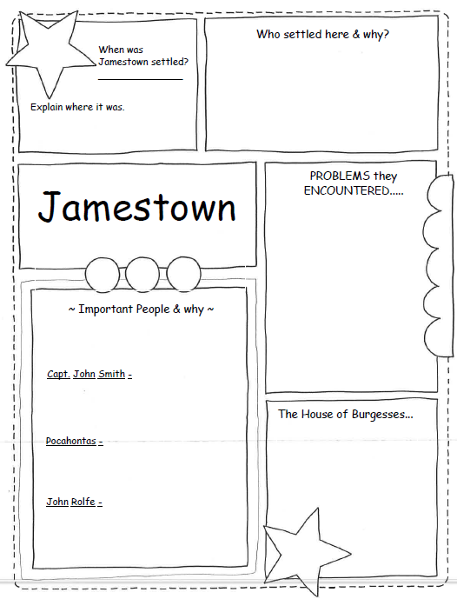
JAMESTOWN
PULL FACTORS:

Slide 2
__________ noble men looking to ______ _______ and get _______ at first.
Later, more __________ people came to Jamestown to grow ______________.
______
Along the shore of _________ River inside of _________________ Bay.
JAMESTOWN
PULL FACTORS:
The ___________ land wasn’t good for ____________ and many ________ the first year.
People weren’t interested in ___________ and no one _____________ or __________ food.
The colonists __________ with the ______________ Tribe over ________.
Capt. John Smith-
Leader of _____________ that made an important rule – anyone who did not _______ did not ______. He saved the colony from failing.
Pocahontas-
Daughter of Chief Powhatan. Stopped her father from killing _______ _______. Her friendship with settlers brought _________ between her people and English.
The ___________ company said colonists could have the _______ _________ as people in England.
People set up this ______- _________ branch of government.
First _____________________ assembly in the English colonies.
Members were ___________ and _____________ the people government.
Only ________ ______who ________ property could run for office and ________.
John Rolfe-
___________ of Jamestown that brought _____________ from the West Indies to the colonies and turned it into a _______ ________.

Slide 3
English noble men looking to find gold and get rich at first.
Later, more English people came to Jamestown to grow tobacco.
1607
Along the shore of the James river inside of Chesapeake bay.
JAMESTOWN
PULL FACTORS: Gold, tobacco
The swampy land wasn’t good for farming and many died the first year.
People weren’t interested in farming and no one gathered or planted food.
The colonists fought with the Powhatan Tribe over land.
Leader of Jamestown that made an important rule – anyone who did not work did not eat. He saved the colony from failing.
The Virginia company said that the colonists could have same rights as people in England. People set up this lawmaking branch of government.
First representative assembly in English colonies. Members were elected and represented the people in government. Only white men who owned property could run for office and vote.
Daughter of Chief Powhatan. Stopped her father from killing John Smith. Her friendship with settlers brought peace between her people and English.
Leader of Jamestown that brought tobacco from the West Indies to the colonies and turned it into a cash crop.

