Slide 1
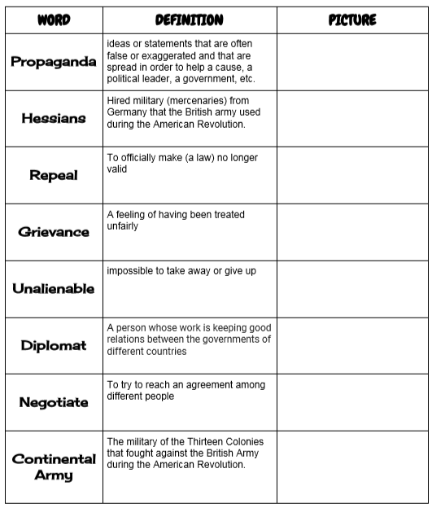
American Revolution Vocabulary: Part 2

