Slide 1
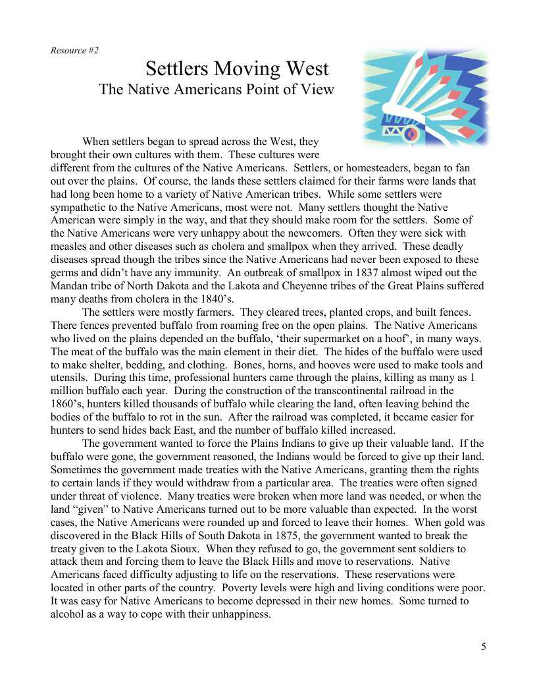

Slide 2
Name: ________________
American Progress
Answer the question: Was the westward movement really progress for all Americans? Use text evidence from the American Progress picture and the reading to support your answer from both viewpoints.
Progress for Settlers?
_________________
Progress for Native
Americans? ______
Support your answer:
1.
2.
3.
4.
Support your answer:
1.
2.
3.
4.

Slide 3
Name: ________________
Answer Key: American Progress
Answer the question: Was the westward movement really progress for all Americans? Use text evidence from the American Progress picture and the reading to support your answer from both viewpoints.
Progress for Settlers?
_________________
Progress for Native
Americans? ______
Support your answer:
Used new found resources from the land
Were able to claim land of their own to farm on.
Transportation was improved because of travel needs.
Communication was improved because of long distances between family member.
Support your answer:
Diseases spread through many tribes –suffered many deaths
Buffalo were being killed as settlers moved onto land. Native Americans used most parts of a buffalo to survive.
Had to give up valuable land and forced to leave their homes.
Moved to reservations where living conditions were poor: caused depression and alcohol abuse.

