Slide 1
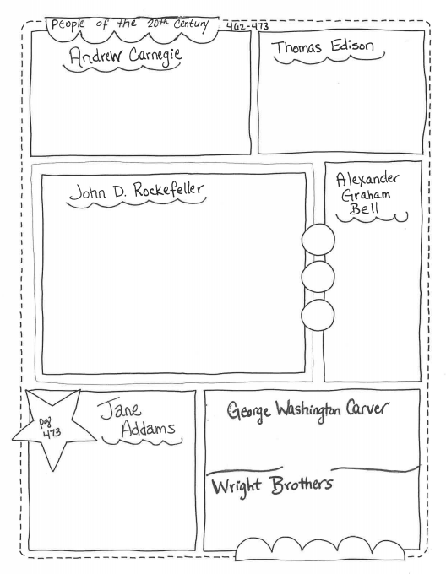

Slide 2
1874 –invented the first practical electric lightbulb
1882 - He set up the 1st electrical power station in New York City.
1872 – Found a new method of making a stronger steel. Opened steel mills and coal and iron mines to supply the mills.
Set up oil refinery that made Kerosene for lamps and grease for wheels.
Bought more refineries and combined all them into one business Stand Oil company.
By 1882, the oil business was so successful that other oil companies could not compete. Rockefeller controlled the entire business.
1876 – Designed a new telephone
1877 - Started first telephone company in the United States.
Invented many uses for the peanut because of over-farming. He suggested planting peanuts to restore nitrogen to the soil.
Opened the first settlement house in the United States for immigrants (Hull House). Provided food, medical care, legal advice, and English classes to immigrants
Invented, built, and flew first airplane successfully.

Slide 3
1874 –invented the first ____________ __________ __________
1882 - He set up the 1st __________ power station in _______ ____ _______.
____ – Found a new method of making a ________ ________. Opened __________ _________and coal and iron mines to supply the mills.
Set up oil ________ that made _________ for lamps and _______ for wheels.
Bought more _________ and combined all them into one business _______ ___ ________.
By 1882, the ____ business was so _________ that other oil companies could not compete. Rockefeller controlled the ______ oil business.
_____ – Designed a new _________
_____ - Started first ________ company in the United States.
Invented many uses for the ________ because of over-_________. He suggested _________ _______to restore __________ to the soil.
Opened the first ___________ ________ in the United States for _________ (Hull _______). Provided food, medical care, _____ _______, and ________ classes to __________.
________, built, and ____ first ___________ successfully.

